Slide 1



The F# Path to Relaxation
Don Syme, Researcher, Developer Tools, Microsoft
.NET fwdays 2021

Slide 2

Hello Kyiv!!!

Slide 3
A Gentle Stroll Through the Land of Language Design and Delivery

Slide 4
A starting position…. Great disputes should be struggled with They are chances to make a simpler, better, more relaxed world

Slide 5
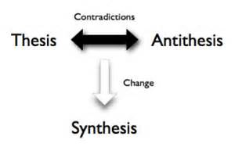
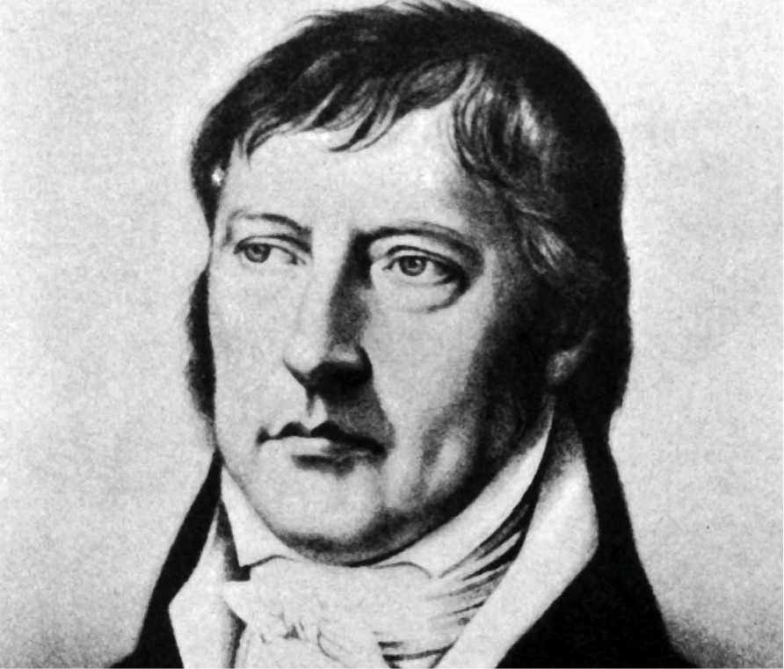
Not a new idea…
The Hegel

Slide 6
X
Y
?

Slide 7
Functional
Interop

Slide 8
Way back in time….. 2003 Functional languages were excellent but isolated, non-interoperable, using their own VMs. Interop standards like COM, CORBA, XML were a mess for language-integration.

Slide 9
The F# Approach (also Scala, Swift, …) Embrace industry-standard runtime layers, and influence them. Design for end-to-end interop. Compromise where needed.

Slide 10
For more! The Early History of F# - HOPL IV (2021) fsharp.org/history

Slide 11
Roll forward to today!

Slide 12

F# get started
dotnet new -lang F# dotnet build
F# tools are part of the .NET SDK, available everywhere
www.dot.net

Slide 13

F# for the web backend
dotnet new -i "giraffe-template::*" dotnet giraffe
High perf, functional server-side programming
A functional ASP.NET Core micro web framework for building rich web applications. github.com/giraffe-fsharp/Giraffe

Slide 14
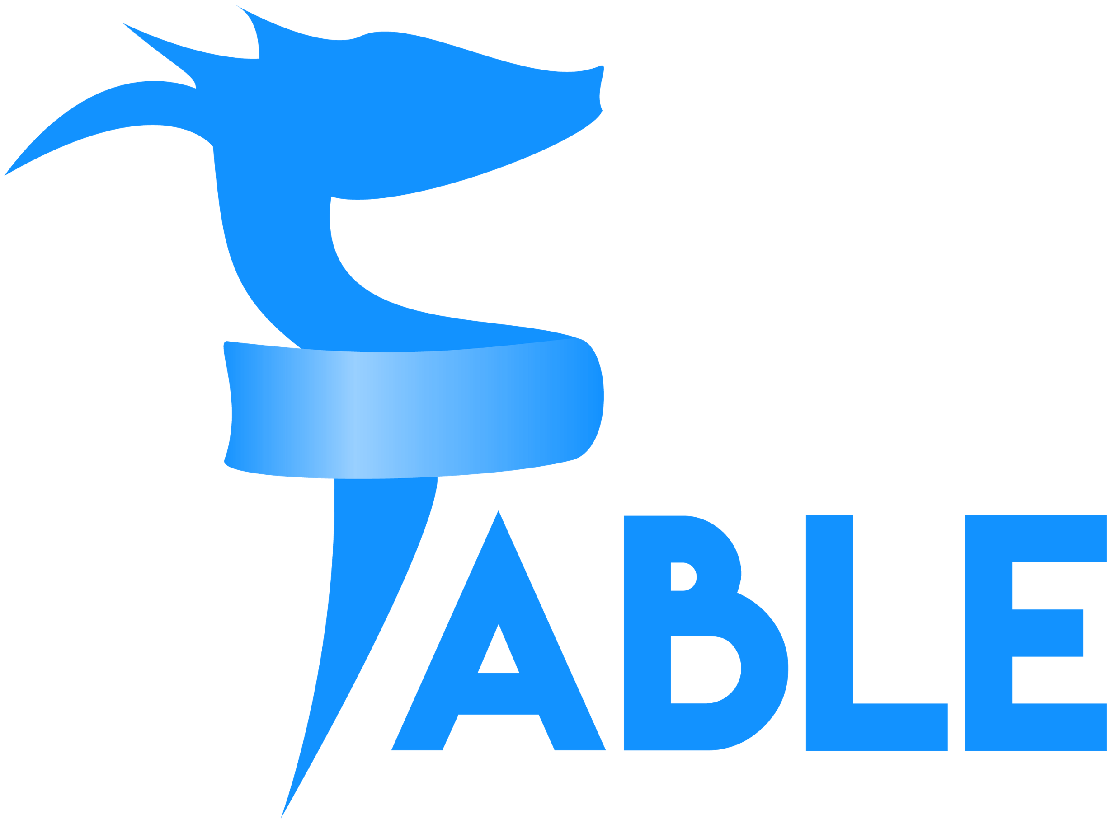
F# for the web frontend (JavaScript)
dotnet new -i "Fable.Template::*" dotnet new fable npm install npm start
You can use F# as a JavaScript language
fable.io
Notes:
WebSharper also includes an excellent JavaScript compiler for F#

Slide 15


F# for the full stack with SAFE
dotnet new -i SAFE.Template dotnet new SAFE dotnet tool restore dotnet run
=
+
+
Notes:
NOTE: other excellent full-stack options exist, including “WebSharper”

Slide 16
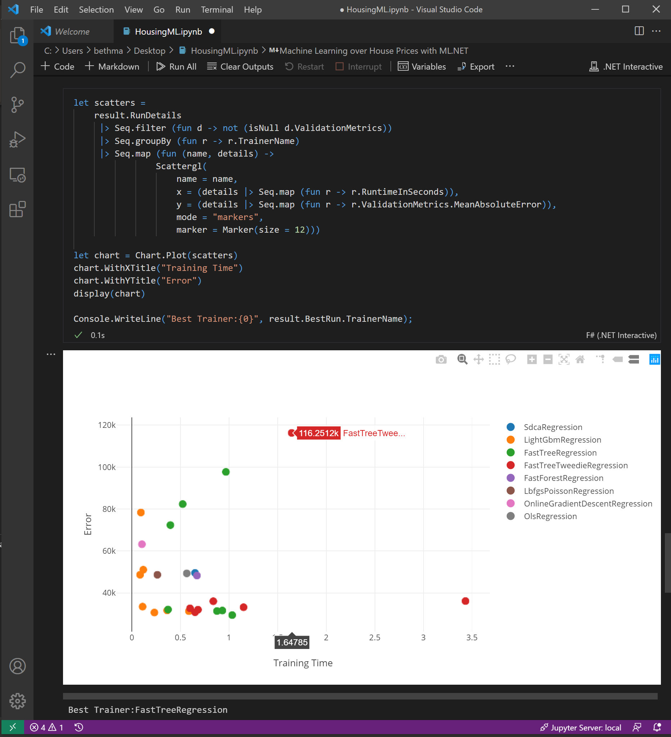
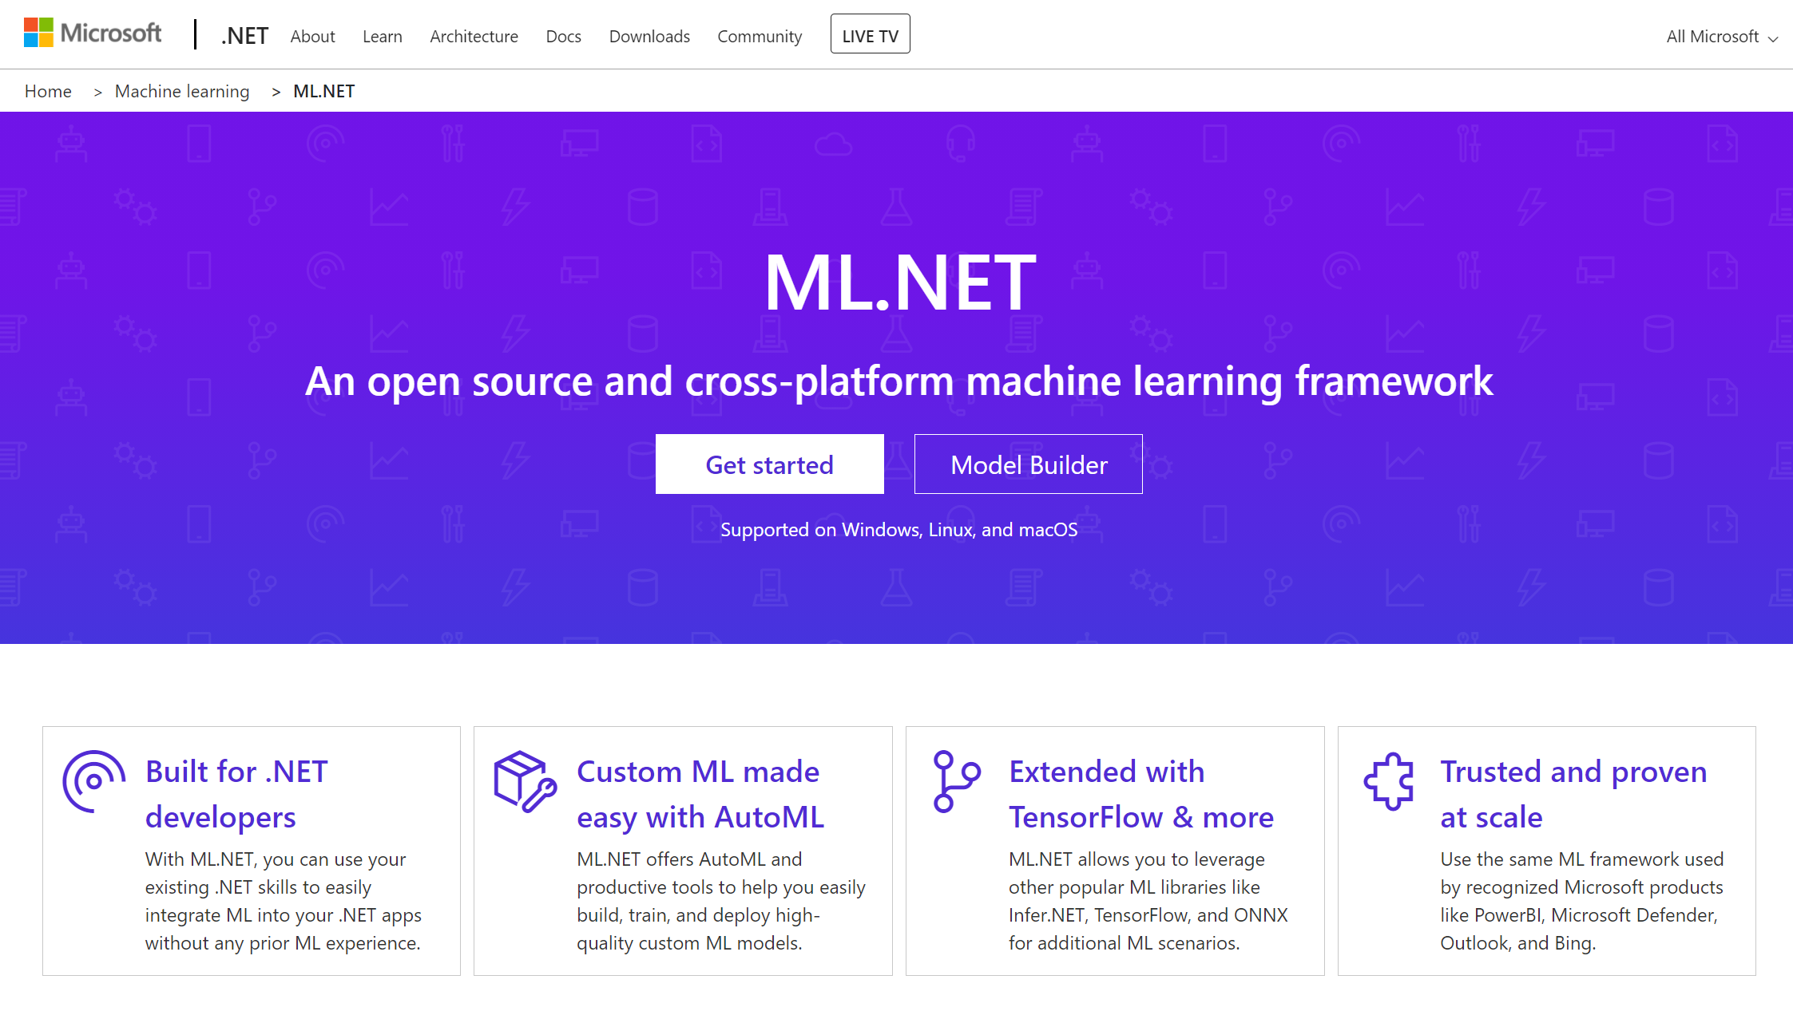
F# for data science & ML
#r "nuget:Microsoft.ML,1.4.0"
#r "nuget:Microsoft.ML.AutoML,0.16.0"
github.com/dotnet/interactive
dot.net/ml

Slide 17
What is F# good at?
dot.net/fsharp

Slide 18
F# is good for programming
dot.net/fsharp

Slide 19
F# is good for web programming
dot.net/fsharp

Slide 20
F# is good for cloud programming
dot.net/fsharp

Slide 21
F# is good for AI/ML/data-science programming
dot.net/fsharp

Slide 22
F# is good for succinct programming
dot.net/fsharp

Slide 23
F# is good for correct programming
dot.net/fsharp

Slide 24
F# is good for performant programming
dot.net/fsharp

Slide 25
F# is good for programming
dot.net/fsharp

Slide 26
A functional-first approach makes a huge difference in practice fsharp.org/testimonials

Slide 27
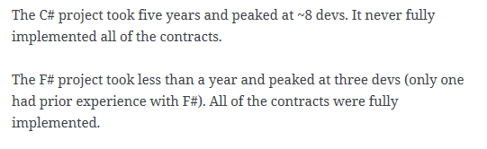
An analysis (Simon Cousins, Energy Sector)
350,000
lines of C# OO
by offshore team
30,000
lines of robust F#, with
parallel +more features
An application to evaluate the revenue due from Balancing Services contracts in the UK energy industry
http://simontcousins.azurewebsites.net/does-the-language-you-use-make-a-difference-revisited/

Slide 28
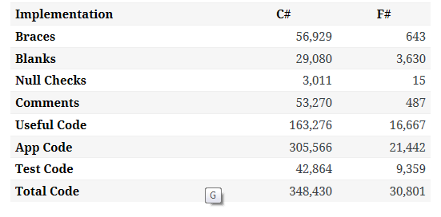

Slide 29
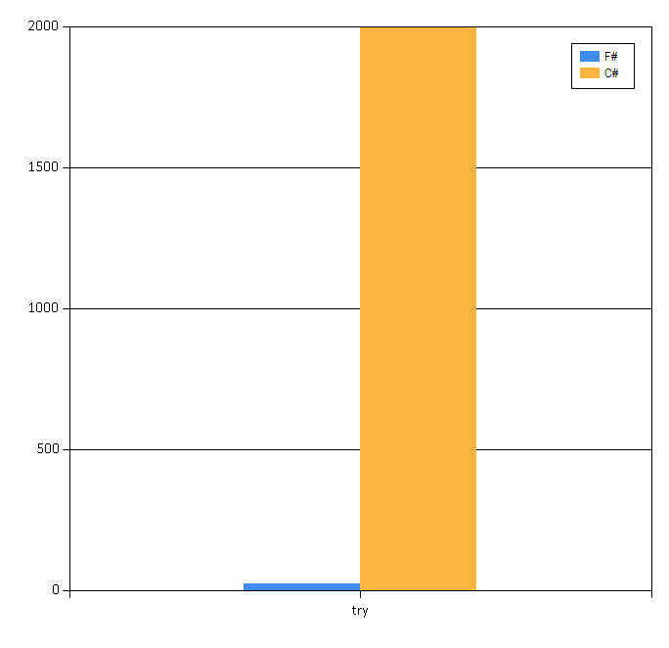

Slide 30
Simon Cousins, Energy Sector
Zero
bugs in deployed system
“F# is the safe choice for this project,
any other choice is too risky”
An application to evaluate the revenue due from Balancing Services contracts in the UK energy industry
http://simontcousins.azurewebsites.net/does-the-language-you-use-make-a-difference-revisited/

Slide 31
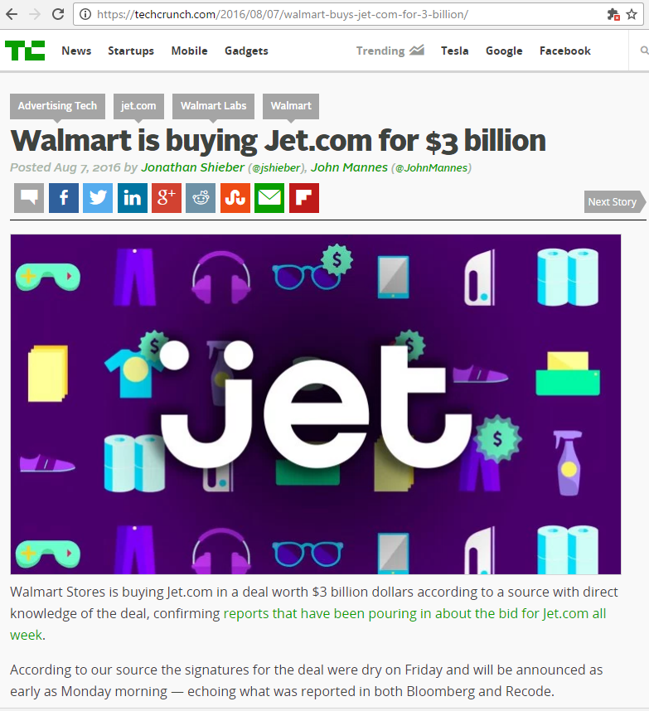
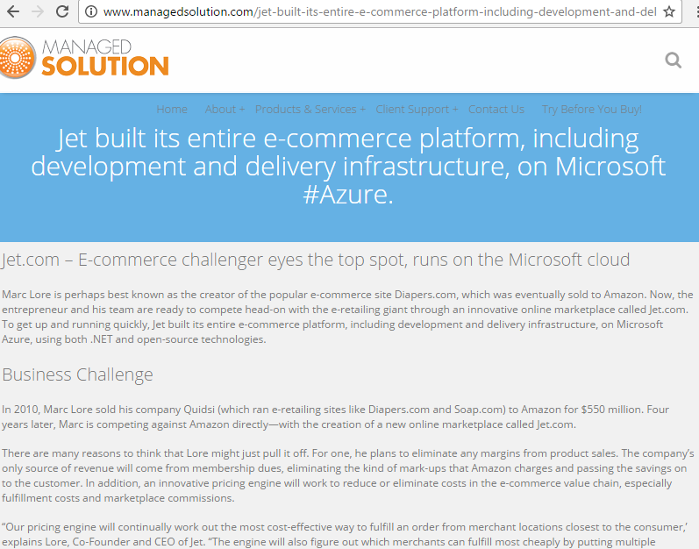
A $3B Unicorn, Built on F#

Slide 32
Relaxation Achieved, 200% ✔ ✔ Today’s FP languages are interoperable ✔ Today’s FP languages are practical
Functional
Interop

Slide 33
X
Y
?

Slide 34
Enterprise
Openness

Slide 35
TL;DR – Where we are now
F# is open, cross-platform, neutral, independent
The F# Compiler Service at the core
F# 5.0 now complete!
.NET Interactive Notebooks for Everywhere
All F# language and tooling is accepting contributions
Fable for F#-to-Javascript
SAFE for F# fullstack
The F# community is very “self-empowered”
fsharp.org
Visual Studio Code for Everywhere
Visual Studio for Windows, Mac

Slide 36
The F# Language Design Process github.com/fsharp/fslang-design github.com/fsharp/fslang-suggestions

Slide 37
F# 5.0! (2021) ✔ #r nuget packages in scripts “#r "nuget: Newtonsoft.Json" ✔ Jupyter and .NET Interactive notebooks! ✔ string interpolation ✔ nameof ✔ applicatives syntax in computation expressions ✔ improved .NET interop ✔ improved Map/Set performance + more
https://github.com/fsharp/fslang-design/tree/master/FSharp-5.0

Slide 38
The F# Compiler Service fsharp.github.io/FSharp.Compiler.Service

Slide 39
Relaxation Achieved ✔ Enterprise Quality + Openness + Community + Tooling + Ecosystem + Evolution Path = Goodness
Enterprise
Openness

Slide 40
X
Y
?

Slide 41
Functional
Objects

Slide 42
Then (2003) In the 1990s functional languages were historically anti-OO “Modern Compiler Implementation with Standard ML” - Chapter 14, Object Oriented Programming object – to express a dislike or distaste for something

Slide 43

F# : Objects + Functional = ️
type Vector2D (dx:double, dy:double) =
let d2 = dx*dx+dy*dy
member v.DX = dx
member v.DY = dy
member v.Length = sqrt d2
member v.Scale(k) = Vector2D (dx*k, dy*k)
Inputs to object
construction
Object internals
Exported properties
Exported method

Slide 44
Objects
Constructed Class Types
type ObjectType(args) =
let internalValue = expr
let internalFunction args = expr
let mutable internalState = expr
member x.Prop1 = expr
member x.Meth2 args = expr
Object Expressions
{ new IObject with
member x.Prop1 = expr
member x.Meth1 args = expr }
{ new Object() with
member x.Prop1 = expr
interface IObject with
member x.Meth1 args = expr
interface IWidget with
member x.Meth1 args = expr }
Object Interface Types
type IObject =
interface ISimpleObject
abstract Prop1 : type
abstract Meth2 : type -> type

Slide 45
Object Programming focuses on … succinct coding, notational convenience API ergonomics good naming practical encapsulation sensible, small, composable abstractions expression-oriented making simple things out of (potentially complex) foundations

Slide 46
Object-Oriented Programming too often means… objects as a single paradigm overuse of hierarchical classification (Animal, Cat, Dog, AbstractJellyBeanFactoryDelegator) large abstractions with many holes and failure points declarations not expressions complex things by inheriting from complex things…

Slide 47
The F# approach is to embrace object programming but not full “object-orientation”

Slide 48
Positive Synthesis Achieved ✔ some limitations remain… and there is one area in particular that’s worth discussing….
Functional
Objects

Slide 49
X
Y
?

Slide 50
Code
Data

Slide 51
We are living through an information revolution

Slide 52
We need to bring information into the language… At internet-scale, strongly tooled, strongly typed

Slide 53
Paradigm Locator
Statically Typed
Dynamically Typed

Slide 54
Enter F# Type Providers…. “Just like a library” “A design-time component that computes a space of types and methods on-demand…” “An adaptor between data/services and the .NET type system…” “On-demand, scalable compile-time provision of type/module definitions…”

Slide 55
https://fsprojects.github.io/FSharp.Data/images/json.gif

Slide 56
Relaxation Achieved ✔ ✔ F# Type Providers have been a hugely successful feature – their range of useful application is enormous. They bring data and typed programming into synthesis like no other feature around
Code
Data

Slide 57
X
Y
?

Slide 58
Async
Simplicity

Slide 59
Pattern Matching
Abstraction

Slide 60
In Conclusion

Slide 61
F# is a magical language It makes programming simple, logical and enjoyable

Slide 62
Remember the Hegel!

Slide 63
Help achieve relaxation today Where there is conflict, find a positive, creative path forward Freedom and relaxation are possible!

Slide 64
Resources fsharp.org dotnet.microsoft.com/learn/fsharp Don Teaches Guido F#

Slide 65
Thank you!! Questions?

